Slide 1

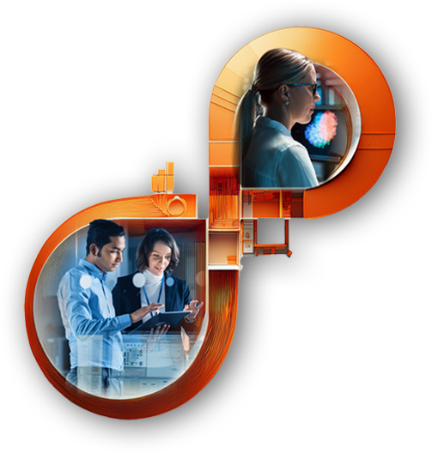
Semicolons 2025
Persistent’s Annual Global Hackathon
OptiMeal
Smarter Meal Management ,Lesser Wastage
Team MUMBAI-3 VESIT

Slide 2
1) Predict food requirements for next day and reduce food wastage
2) OPTIMEAL 3) Team : Mumbai-3 VESIT (NO CUSTOMER NAMES ANYWHERE IN PRESENTATION OR VERBALLY DURING THE PITCH)
Customer/ Market Need
Food Wastage & Shortages: Poor demand forecasting leads to overproduction (wastage) or shortages (delays), in raising costs, operational challenges and inefficiency. Lack of Data-Driven Planning: Reliance on manual estimates results in waste and higher operational costs.
Our Solution ( Approach - AI)
“Our AI-powered system predicts food demand” “Our AI analyzes feedback for better menus.” “Our AI suggests personalized meal options” “Our AI detects peak coffee demand hours”
Key Features
Dashboard Intelligent AI story telling solution with real-time data and historic trends. | Admin Panel Enables cafeteria managers to track food usage, waste, and employee satisfaction, futuristic menu suggestion.
Holiday & Event Suggest prescriptive trends for food preparation, headcount planning, leaves, weather, moon calendar etc. | Predictions Predicts food demand using machine learning to minimize waste and optimize resources.
Benefits to Customers
Reduced Food Waste & Cost Savings: Accurate demand forecasting minimizes overproduction, lowering costs and enhancing sustainability Data-Driven Insights:Comprehensive analytics empower organizations to make informed decisions, boosting both operational efficiency and employee engagement.
Differentiators
Adaptive Learning: Unlike traditional rule-based monitoring, our AI solution learns and adapts over time, offering predictive insights rather than reactive responses. NGO Partnerships & Renewable Conversion: Our system connects with NGOs to repurpose non-edible food waste into renewable gas, enhancing sustainability and creating positive social impact.
Buyer / User Persona
Facilities Managers/Cafeteria Managers
Impactful Metrics
30-35% Sustainable Waste-to-Energy Conversion | <7% Accuracy based on actionable AI | > 40% Peak-Hour Efficiency
Notes:
The NABC (Need, Approach, Benefit, and Competition) framework, developed by Stanford Research Institute (SRI), is a structured way to analyze and present solutions to customer problems effectively. Here’s how you can apply it to a customer problem and use it in a pitch. 1. Need (Customer Problem Statement) • Clearly define the customer’s core problem or unmet need. • Quantify the impact (e.g., lost revenue, inefficiencies, risks). • Example (Telecom Industry): “Telecom companies struggle with network downtime and inefficient fault detection, leading to revenue losses and poor customer experience. Traditional monitoring systems are slow and reactive, causing delays in issue resolution.” 2. Approach (Your Solution) • Explain how your solution works. • Highlight any unique technology, processes, or methodologies. • Example: “Our AI-powered predictive maintenance platform analyzes network performance in real time, detecting anomalies before failures occur. Using machine learning models trained on historical data, we provide proactive alerts and automated issue resolution.” 3. Benefits (Value Proposition) • Describe the tangible benefits for the customer. • Use measurable outcomes like cost savings, efficiency gains, or revenue growth. • Example: “By deploying our solution, telecom providers can reduce downtime by 40%, lower maintenance costs by 30%, and enhance customer satisfaction by ensuring a seamless network experience.” 4. Competition (Market Differentiation) • Identify competitors and alternatives. • Highlight what makes your solution better (e.g., speed, accuracy, ease of use, pricing). • Example: “Unlike traditional rule-based monitoring systems, our AI solution learns and adapts over time, offering predictive insights rather than reactive responses. Compared to competitors, our platform integrates seamlessly with existing infrastructure and provides deeper analytics.” Pitch Structure Using NABC 1. Introduction (Hook the audience with the Need) • “Did you know that telecom operators lose millions annually due to unexpected network failures?” 2. Explain the Approach • “Our AI-driven platform predicts failures before they happen, ensuring proactive maintenance.” 3. Showcase the Benefits • “This reduces downtime by 40%, enhances customer satisfaction, and cuts operational costs.” 4. Highlight Differentiation • “Unlike traditional methods, our solution adapts in real time, providing a smarter, automated approach to network management.

Slide 3
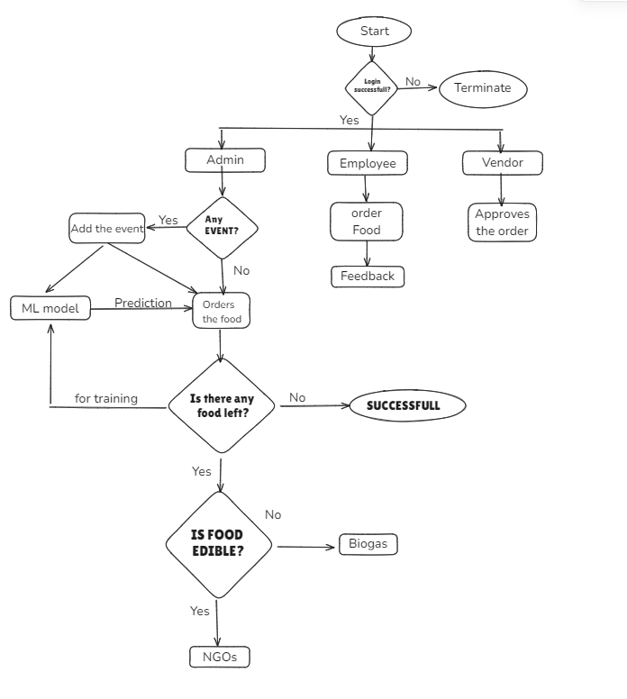
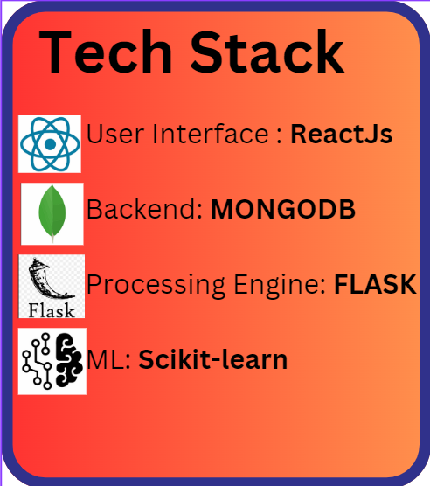
Overall Tech Stack
Architecture Diagram

